Slide 1
Containerization
Improved Benefits:
Security
Portability
Scalability
Speed
Efficiency
Notes:
Kubernetes is “hard” but containers are “easy”. The creation and deployment is handled by your CI/CD orchestration.
Enables support for applications without a complete operating system (Serverless) which is useful if you are deploying your code across a wide range of devices and platforms.
- Containers are changing the way businesses deploy service-oriented applications and their use is expanding within the industry.
- Gartner predicts that the application container market will grow to $3B by 2022.
1. Security
Application isolation allows you to improve security by setting each application’s major process apart from one another in separate containers. This allows you to share specific resources without risking any internal or external security. For instance, if you were working with an outside development team to build an application, you can provide them with just the integration points they need without compromising any information on your own network.
2. Portability
One of the greatest benefits of containerization is that containers are highly portable. When developers move containerized applications across one or many servers, they don’t have to worry about integration issues with the operating system or other inconsistencies that might slow down activity in a traditional computing environment.
3. Scalability
With containerization and a service-oriented application design, you can scale just the functions you want to without affecting the entire application. For instance, this makes it possible to scale the backend components of a web application without scaling the front-end servers. With containerization, scaling is also nearly instant as you are able to add and remove resources rapidly. With more containers, you can scale quickly without the need to setup and configure additional servers.
4 Speed
Another main benefit of containerization is its ability to simplify and speed up the deployment and configuration processes. With containers you can create a single “master” version of your image to quickly deploy on-demand. These containers provide you with the flexibility to quickly create new containerized instances of applications to address growing traffic or rapidly destroy multiple containers to reduce cloud costs.
5. Efficiency
Containerization also provides a new level of efficiency as it promotes a rapid development environment. Containers offer a fast feedback loop that allows developers to change a platform’s source code and instantly track these changes as the applications are running using the same source code. Containerization also helps simplify installation processes and decrease dependency errors, allowing you to save time when installing applications.

Slide 2
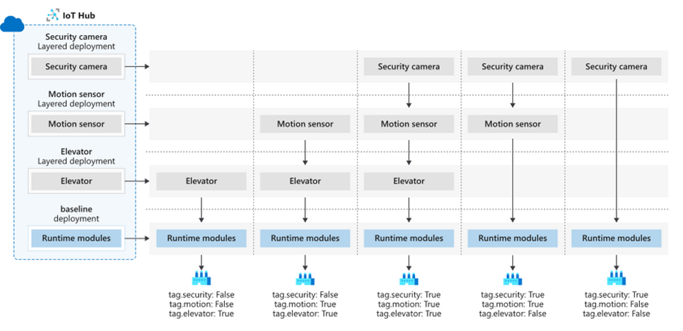
Containerization
Edge use cases with IoT Hub:

